Slide 1
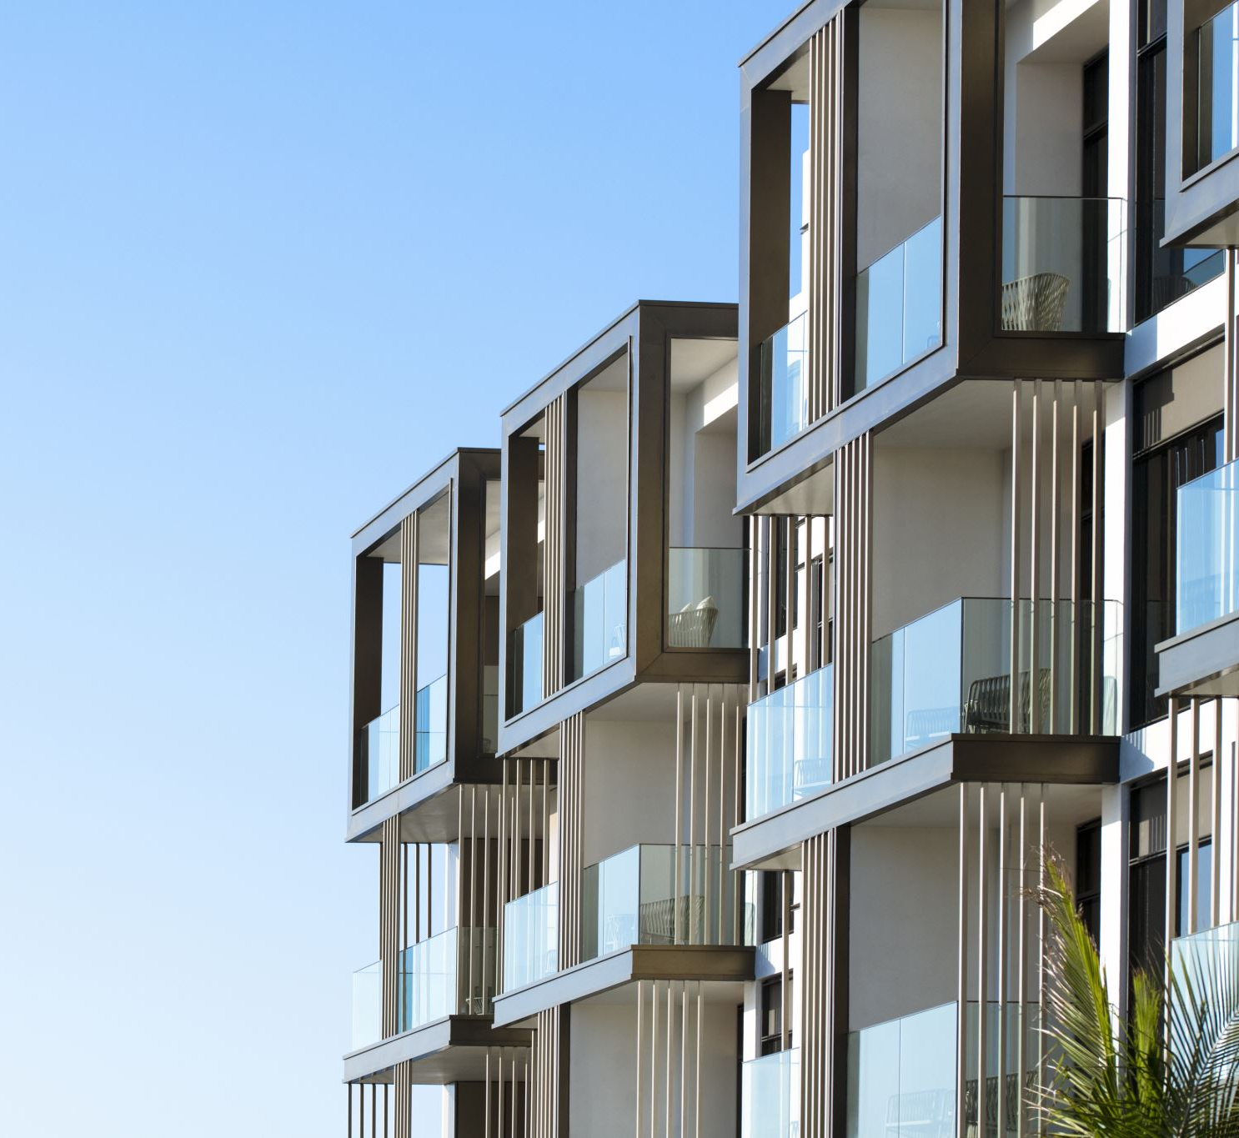
Melbourne Housing Snapshot
IDENTIFYING HOUSING TRENDS IN MELBOURNE

Slide 2
Content
Melbourne Housing Snapshot
Content
ASK
Prepare Data
About the data
Data sources and structure
Metadata
Process
Analyse
Housing data Visualization
Housing Sales
Sales Description
3 bedrooms have the highest sales
Regional Sales
Land size
Bathroom.
Properties.
Descriptive Statistics
Trend

Slide 3

ASK
Find the insight or predict the next big trend

Slide 4
Prepare Data
About The Data
Data Sources and structure
Metadata

Slide 5

About the data
This information was compiled by Tony Pino from publicly accessible results released weekly on Domain.com.au. Now it's up to you to do data analysis wizardry, since he's done his part. The information contains Address, Type of Real Estate, Suburb, Method of Selling, Rooms, Price, Real Estate Agent, Date of Sale, and distance from the Central Business District.

Slide 6

Data sources and structure
The data was obtained from DanB's posting on Kaggle.com and was licensed by CC BY-NC-SA 4.0
This is intended as a static (unchanging) snapshot of https://www.kaggle.com/datasets/dansbecker/melbourne-housing-snapshot?select=melb_data.csv. It was created 2019. Additionally, homes with no Price have been removed..
The data was presented in csv which allows data to be saved in a tabular format.

Slide 7

Metadata
Rooms: Number of rooms
Price: Price in dollars
Method:
S - property sold; SP - property sold prior; PI - property passed in; PN - sold prior not disclosed; SN - sold not disclosed; NB - no bid; VB - vendor bid; W - withdrawn prior to auction; SA - sold after auction; SS - sold after auction price not disclosed. N/A - price or highest bid not available.
Type: br - bedroom(s); h - house,cottage,villa, semi,terrace; u - unit, duplex; t - townhouse; dev site - development site; o res - other residential.
SellerG: Real Estate Agent
Date: Date sold
Distance: Distance from CBD
Regionname: General Region (West, North West, North, North east …etc)
Propertycount: Number of properties that exist in the suburb.
Bedroom2 : Scraped # of Bedrooms (from different source)
Bathroom: Number of Bathrooms
Car: Number of carspots
Landsize: Land Size
BuildingArea: Building Size
CouncilArea: Governing council for the area

Slide 8
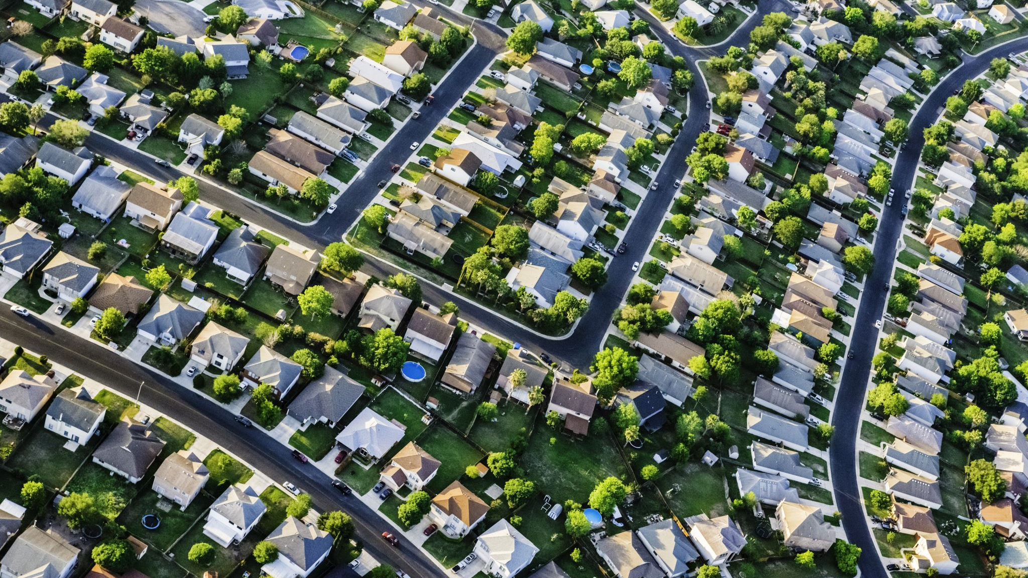
Process
There were no further data available throughout the analytical procedure. Council area, year of construction, and building area were lacking data. This Missing values will not impact the result.
By referencing the provided metadata, we were able to insert new columns into the database that would reveal the full meaning of the encoded names.

Slide 9
Analyse
R
Excel
Tableau
Tools Used

Slide 10
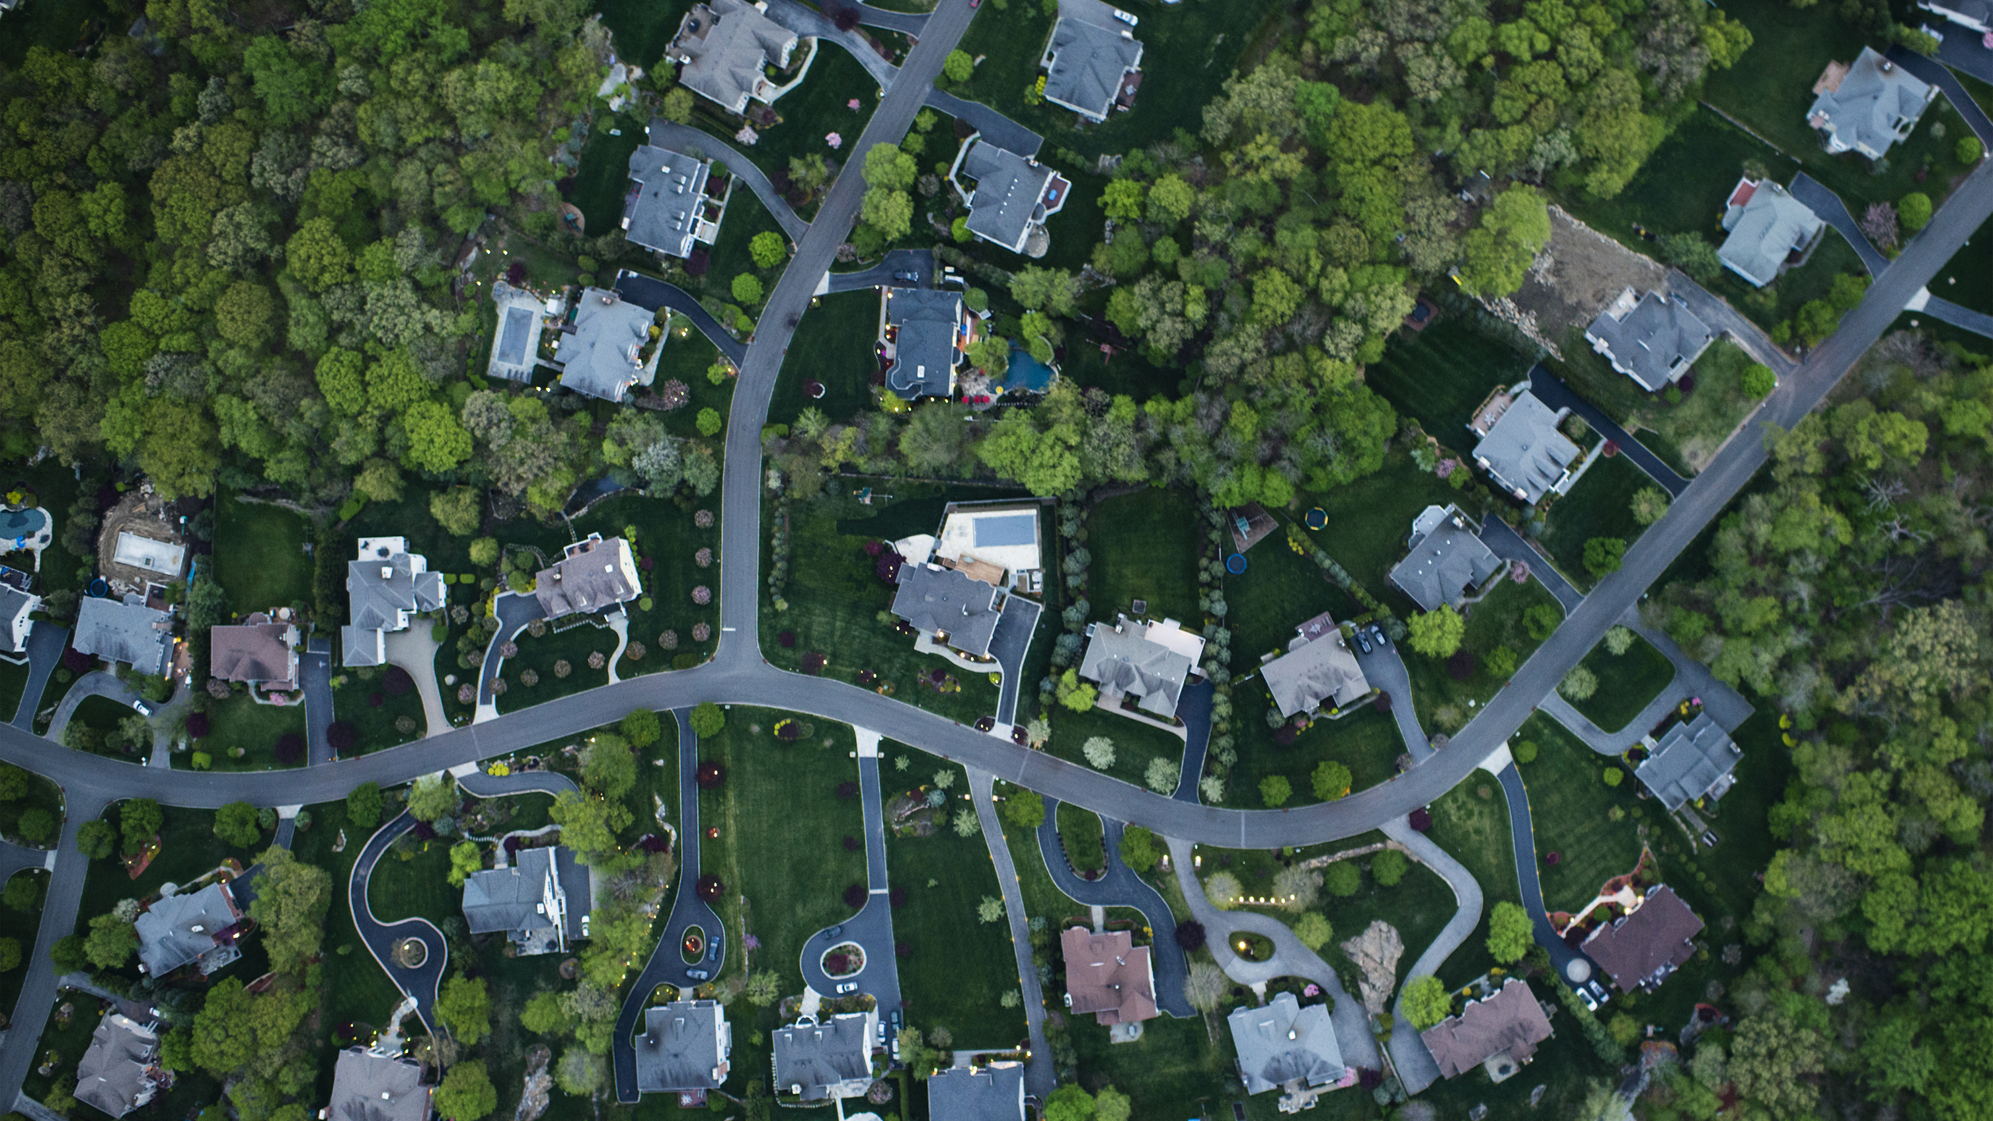
Housing data Visualization

Slide 11
Housing Sales

Slide 12

Sales Description
The most popular property Is the house, cottage, villa, and terrace.
Overall, the unit duplex has the lowest sales volume.
Annually, the third and fourth quarters had the greatest sales volume.

Slide 13
3 bedrooms have the highest sales

Slide 14
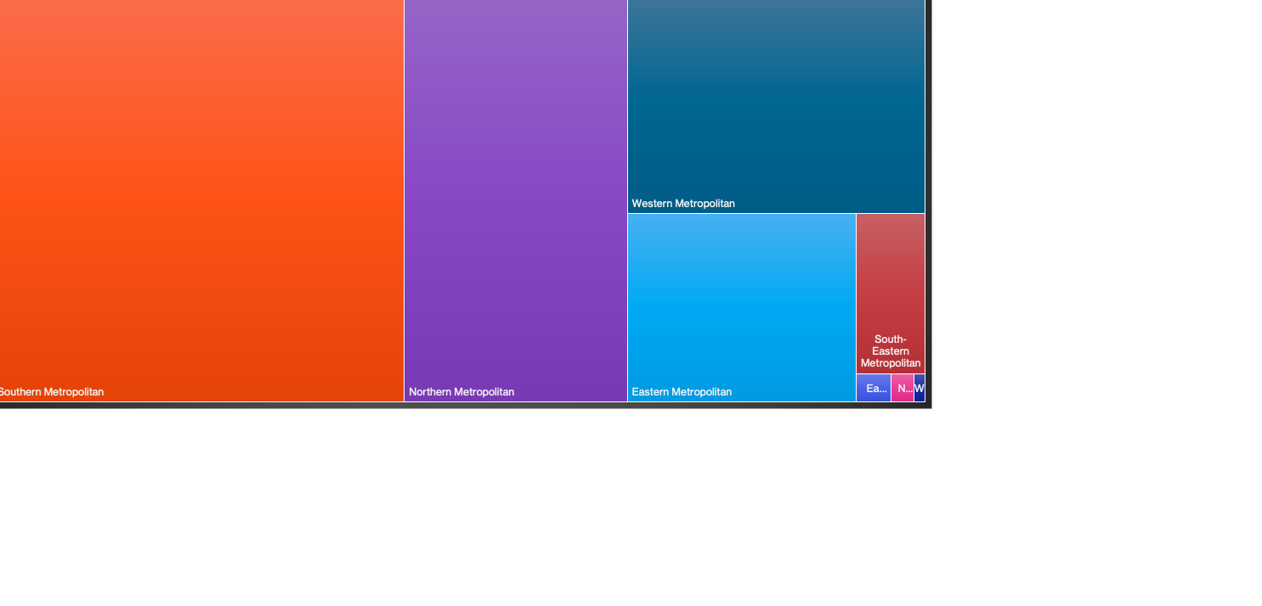
Regional Sales

Slide 15
Number of rooms': 3 bedroom and 4 bedroom have noticeably higher 'Landsize'.

Slide 16
'Bathroom': 1 and 2 have noticeably higher 'Price'.

Slide 17
house, cottage, villa, semi, terrace accounts for the majority of 'Properties'.

Slide 18

Descriptive Statistics

Slide 19
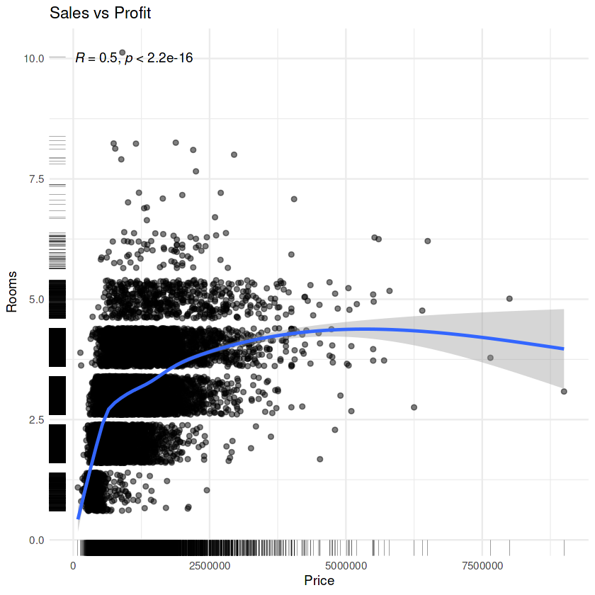
correlation between price and number of rooms
A correlation coefficient of 0.5 suggests that there is a link between price and number rooms available that is reasonably strong. The more number of rooms the higher the price, despite the fact that other factors may also impact such increases.

Slide 20
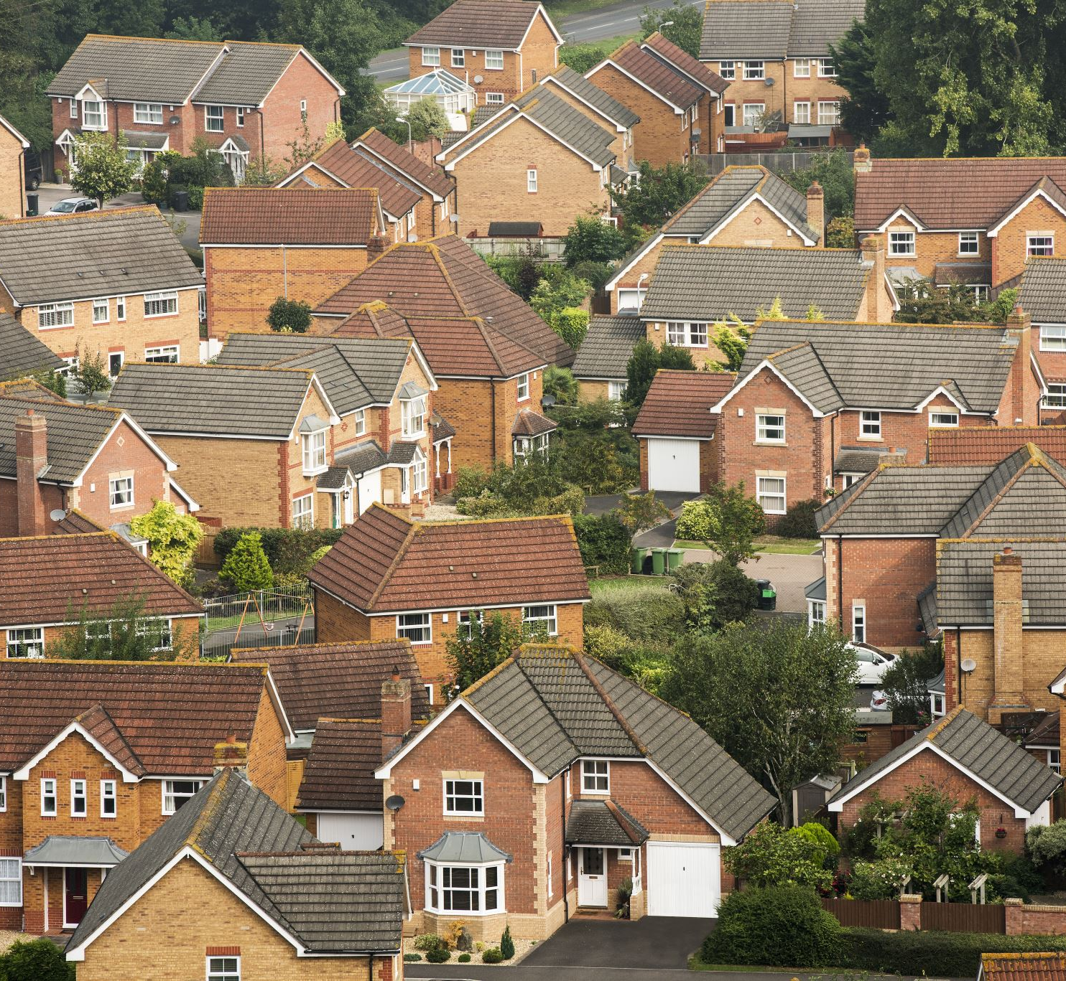
Trend
Southern Metropolitan has achieved the most sales, indicating that people adore living there. Houses, cottages, villas, semi-detached homes, and terraces are better real estate investments than apartments and commercial buildings, which have seen relatively low sales growth over the years.

